Slide 1

FEZA SHOP-shop in style
Feza programming club

Slide 2
programming club
We are a space where students learn to build with technology and turn ideas into reality through code.
Programming teaches logic, problem-solving, creativity and essential skills for any career..
Also programming encourages collaboration, mentorship, and support among students.
In programming we don't just read about code; we build projects.

Slide 3
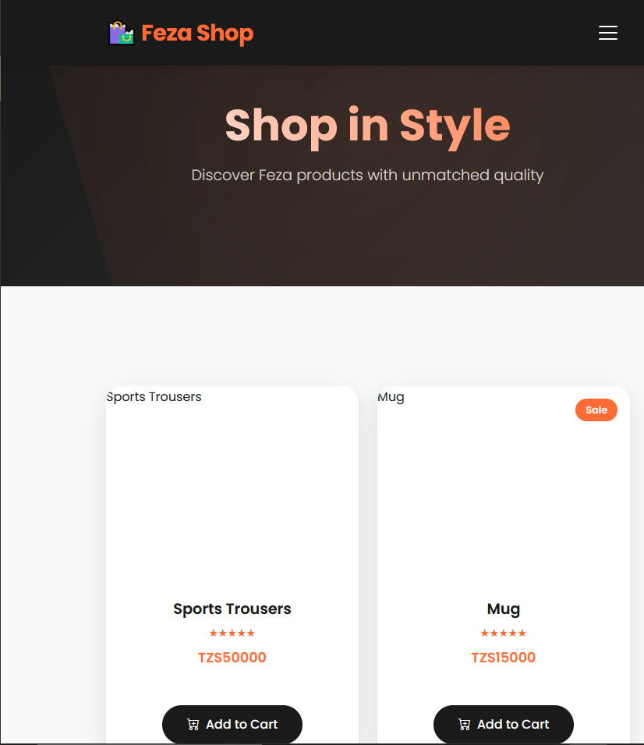
Why Shop Online with Us?
No more rushing to the local store or dealing with limited supply times. Order 24/7 from home
IN YOUR PHONES OPEN www.fezashop.com TO ACCESS THE WEBSITE
All items (uniforms, gear) are pre-approved and meet school standards, ensuring your child has the right stuff.
Easy Returns & Sizing: Simple online size charts and a straightforward return/exchange policy if it doesn't fit right

Slide 4
Shopping Made Simple: A Quick Tour
FEZA SHOP HAS TANZANIAN BANKING AND MOBILE PAYMENTS LIKE :
  M-PESA
  MIXX BY YAS
  HALOPESA
  AIRTEL MONEY
  NMB BANK
  CRDB BANK
  PLEASE VISIT www.fezashop.com
QR
CODE
HERE

Slide 5
Feza Shop: WHERE IT ORIGINATED
FEZA SHOP IS ACTUALLY CREATED FROM THREE CODING LANGUAGES WHICH ARE HTML,JAVASCRIPT AND CSS
IN THIS WEBSITE JAVASCRIPT WAS USED TO to save and retrieve the cart.
HTML WAS USED TO define the entire structure and content of the shopping website, from the navigation bar and product layout to the hero section, cart modal, and footer.
CSS WAS USED TO define the website's visual presentation, styling the HTML elements by setting colors, fonts, layout, and responsiveness to create a cohesive and appealing user interface.
FEZA SHOP IS A 100% STUDENT MADE WEBSITE AND IT IS SECURED TO KEEP THE USER’S INFORMATION SAFE

Slide 6
WHY CREATE FEZA SHOP?
To streamline and manage the mandatory supply chain:We eliminate the hassle of physical trips and confusing supply lists. By centralizing all approved school and club gear online, we ensure you can shop quickly and confidently, any time.
To offer an efficient, transparent purchasing process:Our site provides clear, upfront pricing and secure digital payment options. This transparency, combined with occasional online-only bundles and deals, ensures you receive the best value for mandatory items
To provide a convenient and always-accessible shopping experience:The website is built around your busy schedule, allowing you to order uniforms, books, and supplies in three minutes at midnight, and giving you peace of mind that your child will have the exact, approved items they need for school.

Slide 7
Thank You
QR
CODE
HERE
Scan me
FEZA PROGRAMMING CLUB
www.fezashop.com
www.fezashop.com

